Slide 1
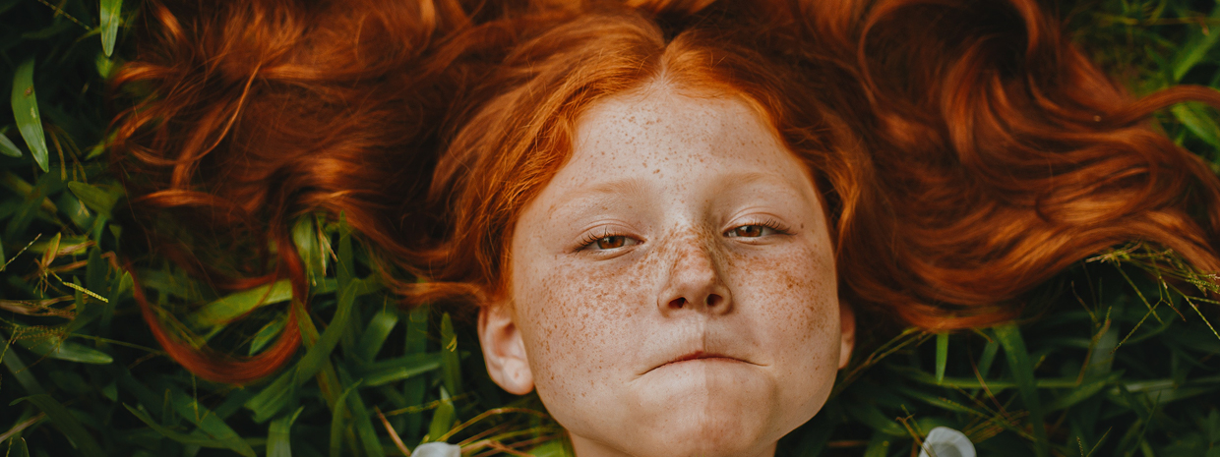
Quaaltagh
A Manx New Year tradition

Slide 2
Celebrations!
New Year is a time to visit friends and family and celebrate.
There is a Manx tradition that is linked to who the first person is through your door in the New Year.
This person could bring you good luck or bad luck depending whether they are the “right” kind of person!

Slide 3
The Quaaltagh
The quaaltagh is the tradition of being the first person through the door of another household on New Years Day.
Very often if you were the quaaltagh then you would be offered something to eat or drink.
“There was an old custom among the Manx people called the “quaaltagh” – a person came to wish them a happy new year, and of course they could not do it well without a glass of rum.”
The Manx Sun 8th January 1859

Slide 4
Party time
Sometimes the quaaltagh celebrations could get quite rowdy as the New Year celebrations carried on.
In 1864 the Manx Sun reported:
“the streets were thronged by the usual number of noisy quaaltaghs rushing from house to house.”
In 1887 the Manx Sun reported:
“a general ringing of bells and blowing of horns and the town was alive and noisy…”

Slide 5
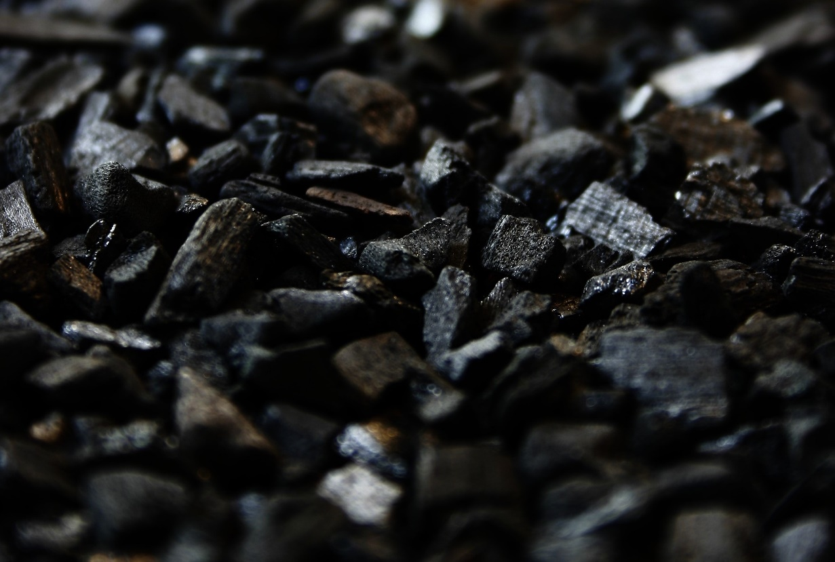
Who will bring luck?
Although many men and boys roamed the streets during quaaltagh it was thought that a dark haired man would bring the most luck if he was your first footer.
He should bring a small gift with him, sometimes a lump of coal, and he should be treated well when he has entered the house.
“The quaaltagh brings the luck for the year. He wishes all sorts of good wishes to the members of the household…”

Slide 6
The quaaltagh
The Isle of Man Times in 1960 shows how the tradition was still continuing.
“Dark haired men are in great demand… but the quaaltagh should be a matter of chance, not design… if a fair man was the first to cross the threshold, the year would not be a very prosperous one… if a woman was the first to enter a house the year would be a disastrous one.”

Slide 7
Remembering the quaaltagh
Listen to the following sound clip and see if you can spot any similarities to what we have already learnt.

Slide 8
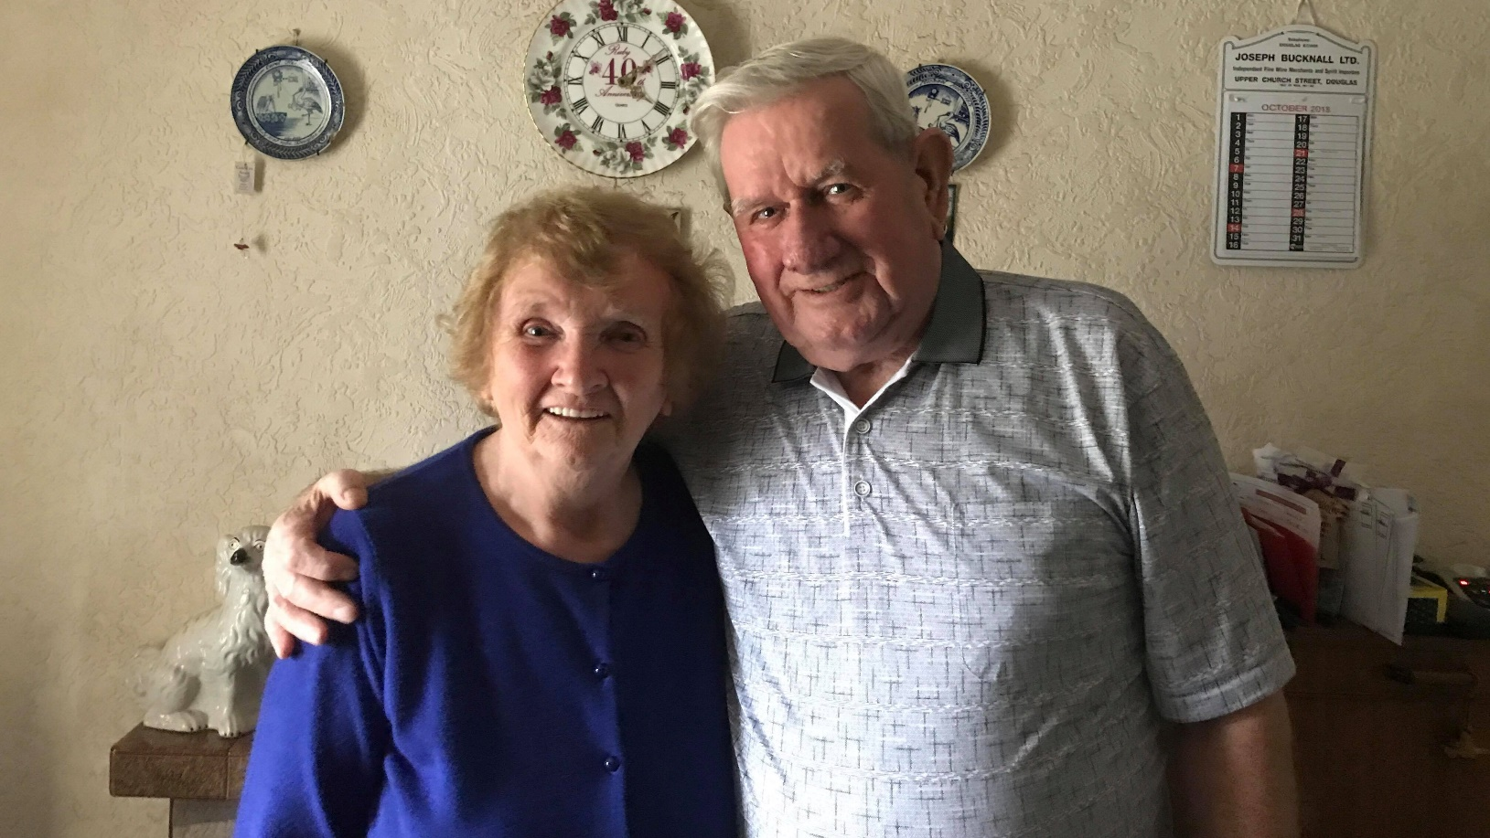
Lenny & Mona Kerruish

Slide 9
The qualtagh blessing
If you were very lucky then your qualtagh might recite this blessing on you and your household:
Shoh slaynt as shee as eash dy vea,
As maynrys son dy bragh.
/
Here's health and peace and age of life,
And happiness for ever.
Perhaps you could learn the blessing and visit somebody as their quaaltagh next year!

Slide 10
More information
There is a lot more information about the qualtagh on the Culture Vannin website:
www.culturevannin.im/manx_year_event_574047.html

