Slide 1
Oie Noo Markys
St. Mark’s Eve

Slide 2
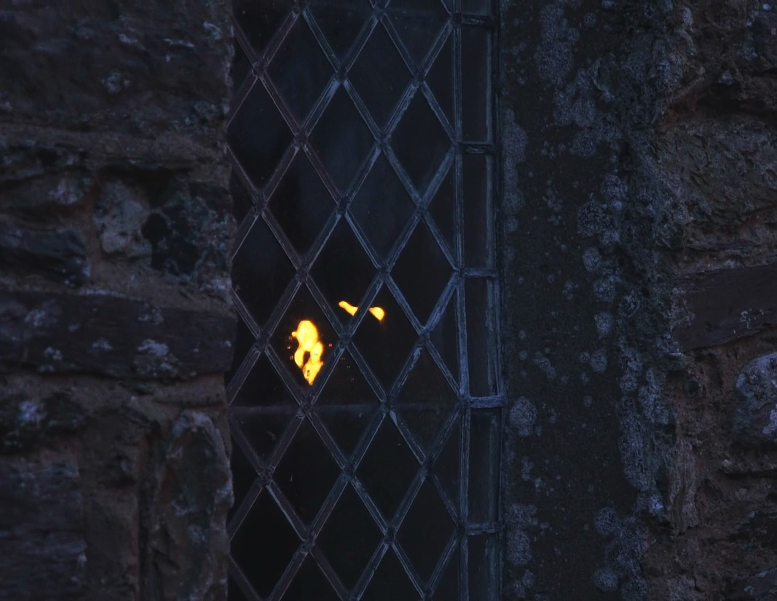
Strange happenings
Oie Noo Markys is Manx for St. Mark’s Eve.
It is a strange night in the Manx calendar.
It falls on 24th/25th April and it is thought that the border between this world and the next world is very thin at this time.
Because of this, people believed that you could catch a glimpse of souls during this night.

Slide 3
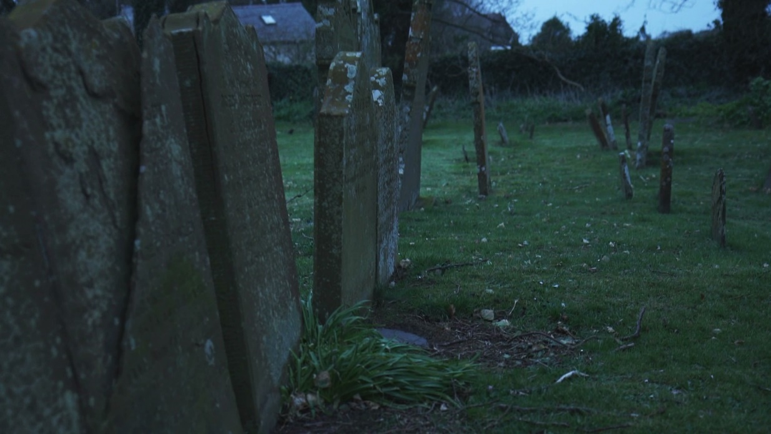
Stay awake!
It was believed that on the night of 24th/25th April, the souls of those who were to die in the coming year would leave their mortal bodies and visit the graveyards.
It was thought that if you went to the church porch between 11pm and 1am you would see these souls.
If you stayed awake then your soul could not leave your body, ensuring you would live another year!

Slide 4
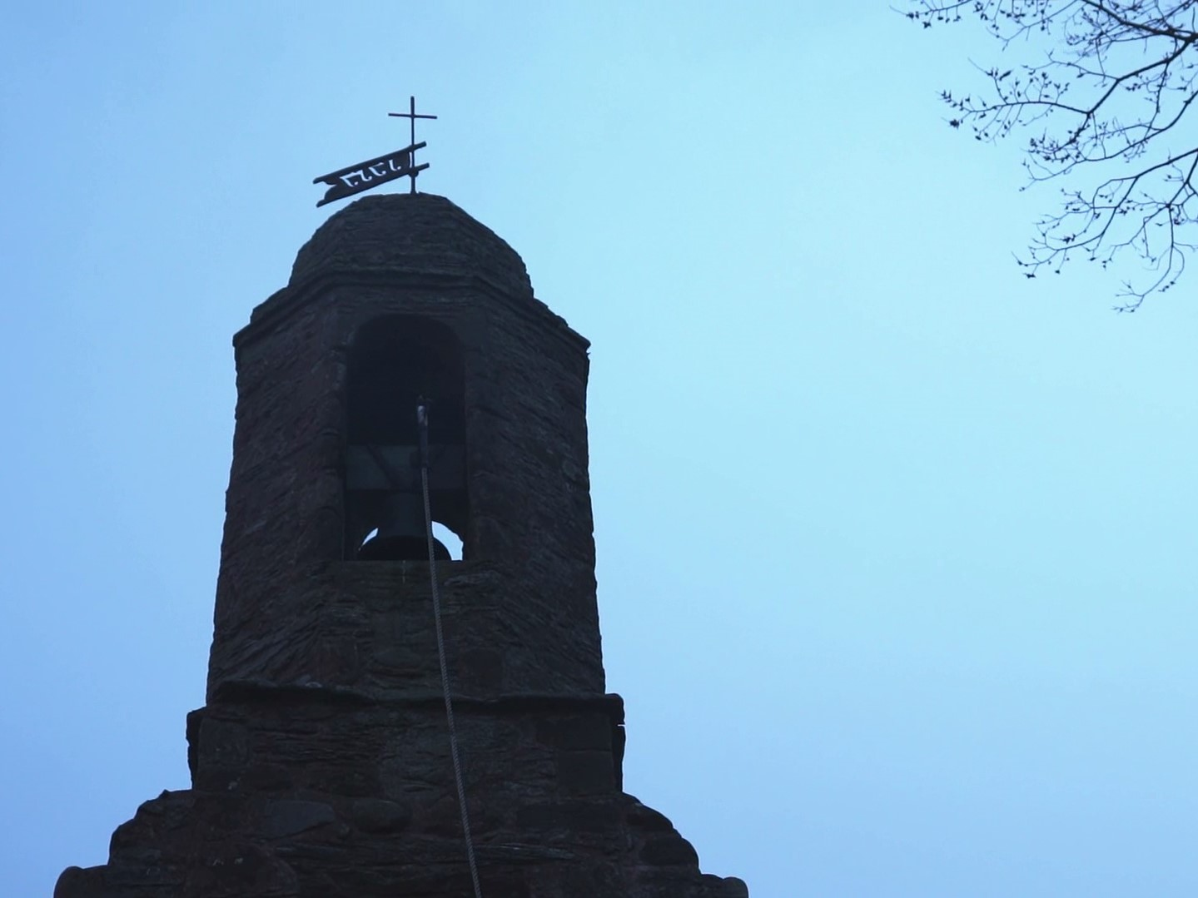
Does this information back up what you have learnt so far?
“A curious belief that the souls of all people left their bodies when asleep on this night, and wandered to the place where they would die… and so arose the custom of sitting up to watch, and so avoiding such an occurrence.”
A. W. Moore Folklore of the Isle of Man (1891)

Slide 5
More information
Watch the short film that follows all about Oie Noo Markys…

